Slide 1
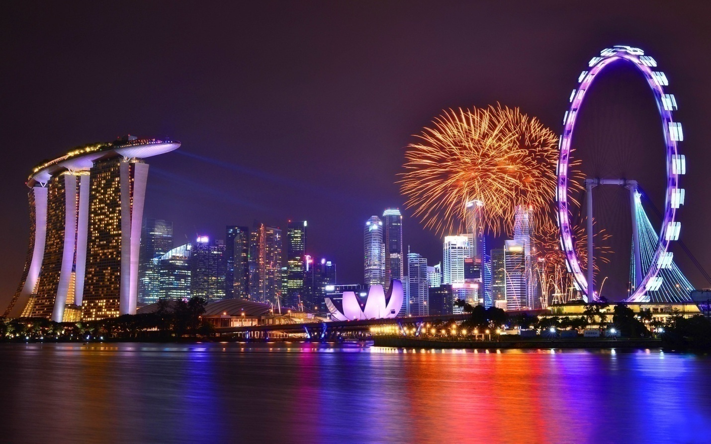
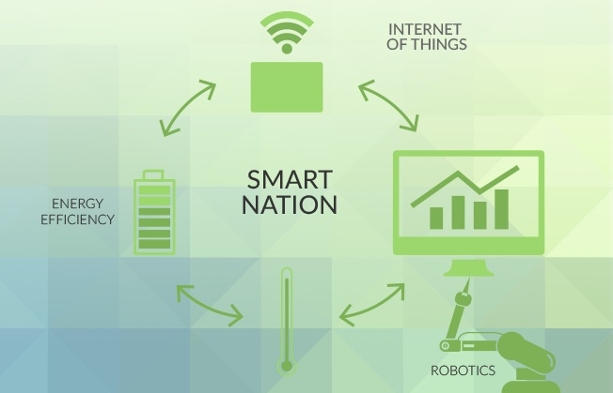
Big Data for a Smart Nation!
- Hiranand Acchra

Slide 2

Vision
To become the World’s FIRST Smart Nation

Slide 3
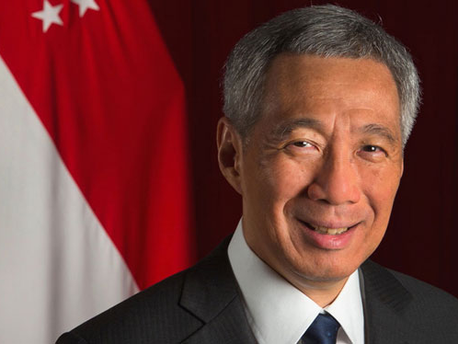
Lee Hsien Loong, Prime Minister, Singapore
“A nation where people live meaningful and fulfilled lives, enabled seamlessly by technology.”
At the launch of Smart Nation Initiative, November 2015

Slide 4
Why Singapore?
97% of households with school going children have access to computers
Mobile penetration of 1.5 per person
Smart Phone penetration highest in the world
Population is IT-savvy and understands technology
Ethos is rational, technological and forward-thinking
# 1 in Ease of Doing Business – World Bank
7000 MNCs based in Singapore
# 1 IN World Economic Forum Network Readiness Ranking
Has 2 top 50 World Ranking Universities
Introduced e-Tax Filing back in 1998

Slide 5
Home & Environment
Transport
Business Productivity
Health & Enabled Aeging
Public Sector Services
Domains affecting
Citizens & Society

Slide 6

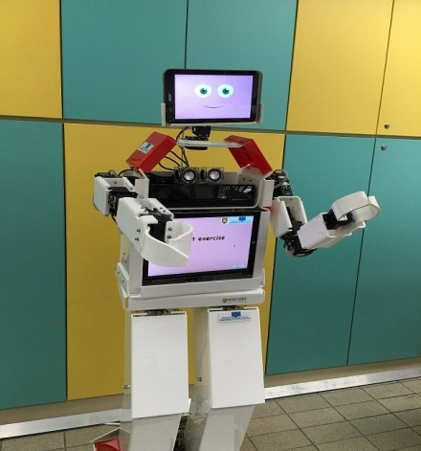


INITIATIVES IN HEALTH
Elderly Monitoring System
Assistive Tech & Robotics
HealthHub Portal
National Steps Challenge
Tele-Health
RoboCoach
Healthy 365

Slide 7
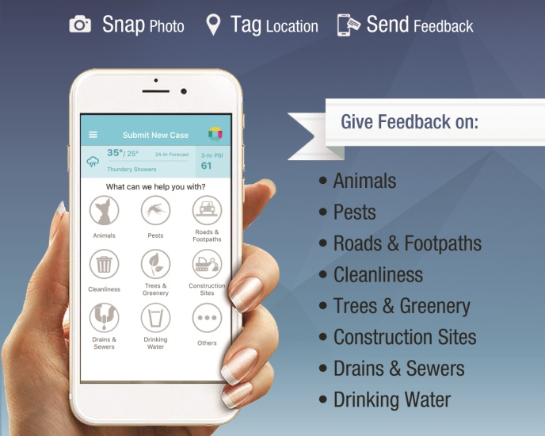
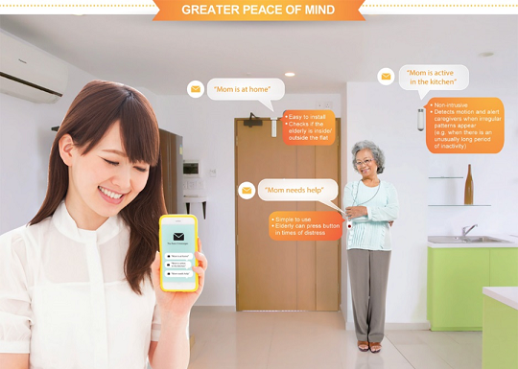
INITIATIVES IN LIVING
Informed of our Environment
Smart Homes
My Smart HDB Home
OneService

Slide 8
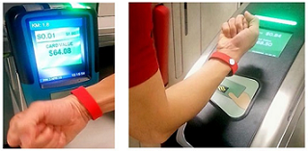
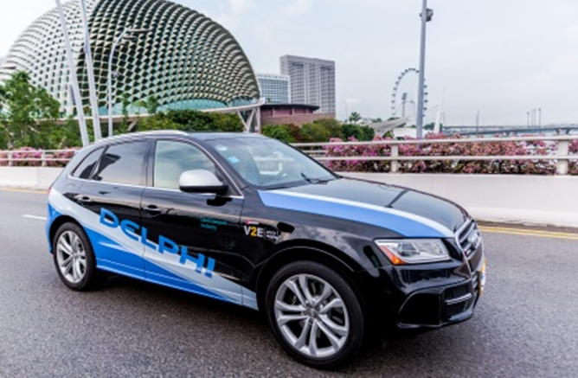
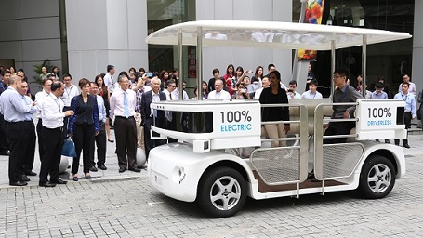
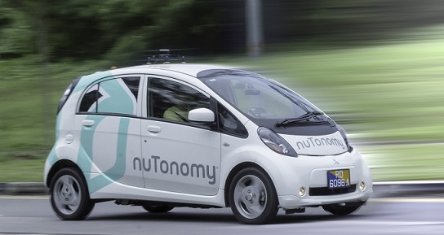
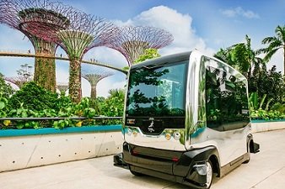
INITIATIVES IN MOBILITY
Contactless Fare Payment
Mobility-on-Demand
Self Driving Vehicles Technology
Self Driving Electric Shuttle
AutoRider

Slide 9
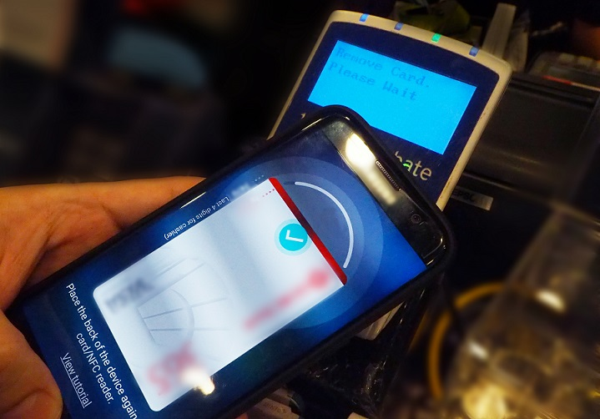

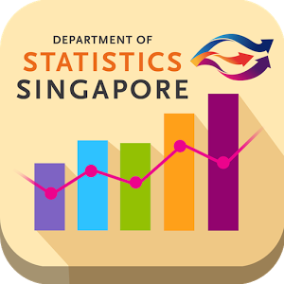

INITIATIVES IN SERVICES
Contactless Payment Solution
FinTech Sandbox
Public Service at Fingertips
SingStat Mobile App

Slide 11
Reference:
www.smartnation.sg

Slide 12
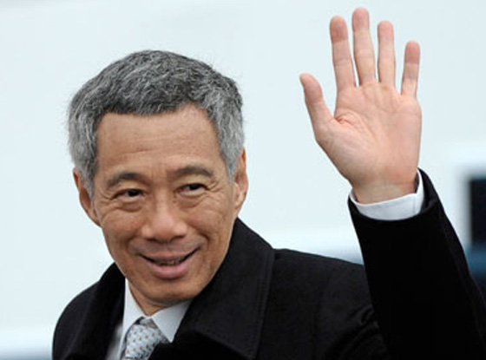
Thank You!

